Slide 1
Jeopardy!
Life skills

Slide 2
In the Kitchen | Staying Healthy | Money | Out and About | Healthy Living | Just Fun!
100 | 100 | 100 | 100 | 100 | 100
200 | 200 | 200 | 200 | 200 | 200
300 | 300 | 300 | 300 | 300 | 300
400 | 400 | 400 | 400 | 400 | 400
500 | 500 | 500 | 500 | 500 | 500

Slide 3

In the Kitchen 100 points
What is the first thing you should do before you begin preparing food or cooking?

Slide 4
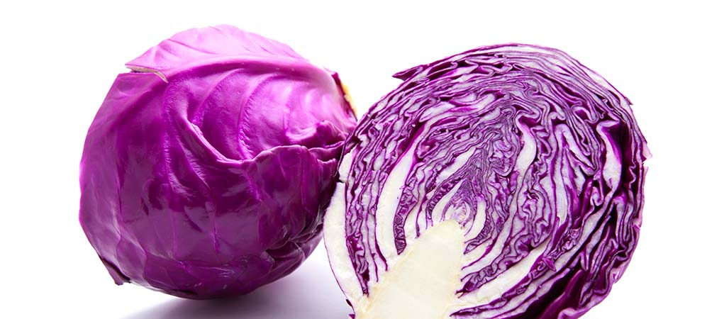
In the Kitchen 200 points
Name this veggie
Cabbage!

Slide 5
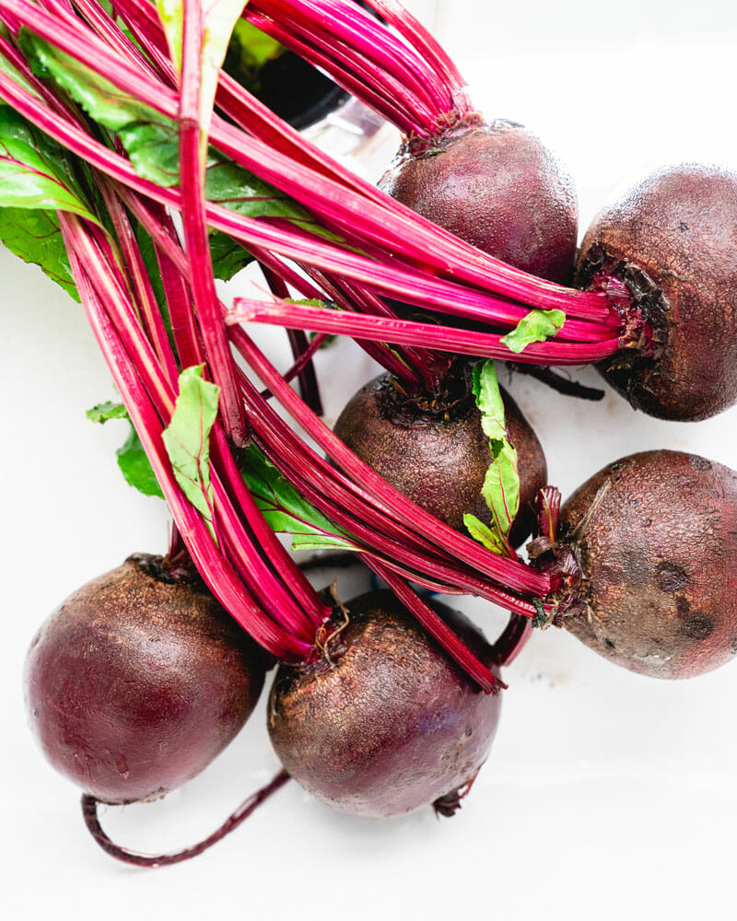
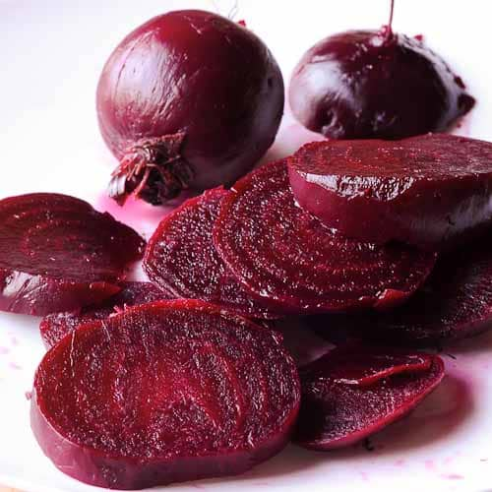
In the Kitchen 300 points
Name this veggie
Beets!

Slide 6
In the Kitchen 400 points
What is one source of protein?
Eggs, Meat, Nuts

Slide 7
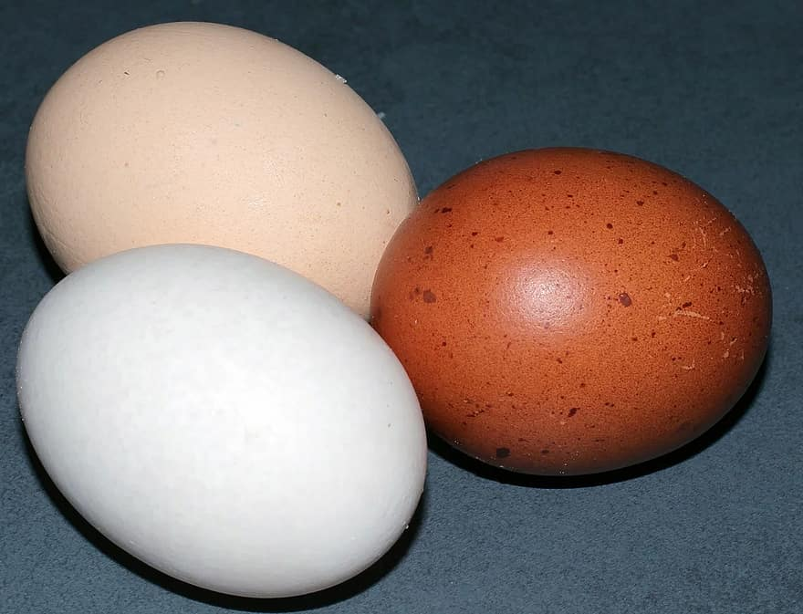
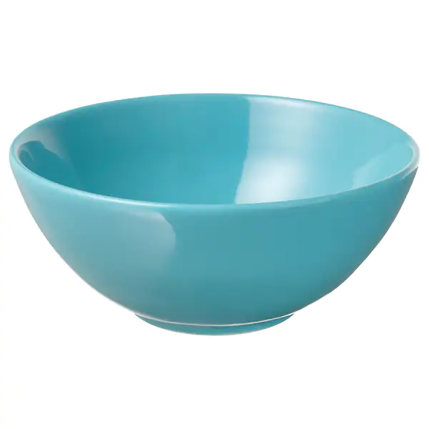
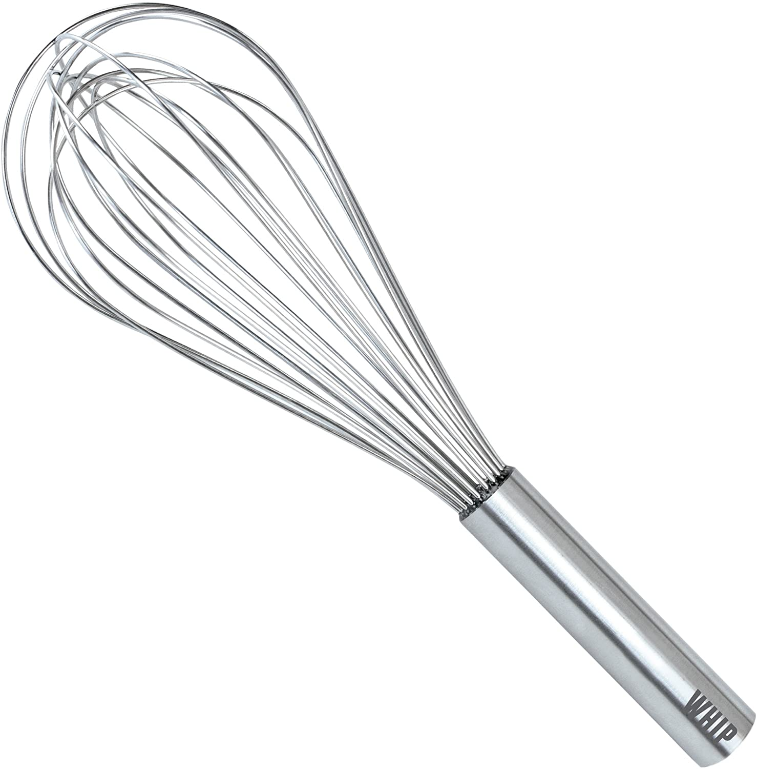
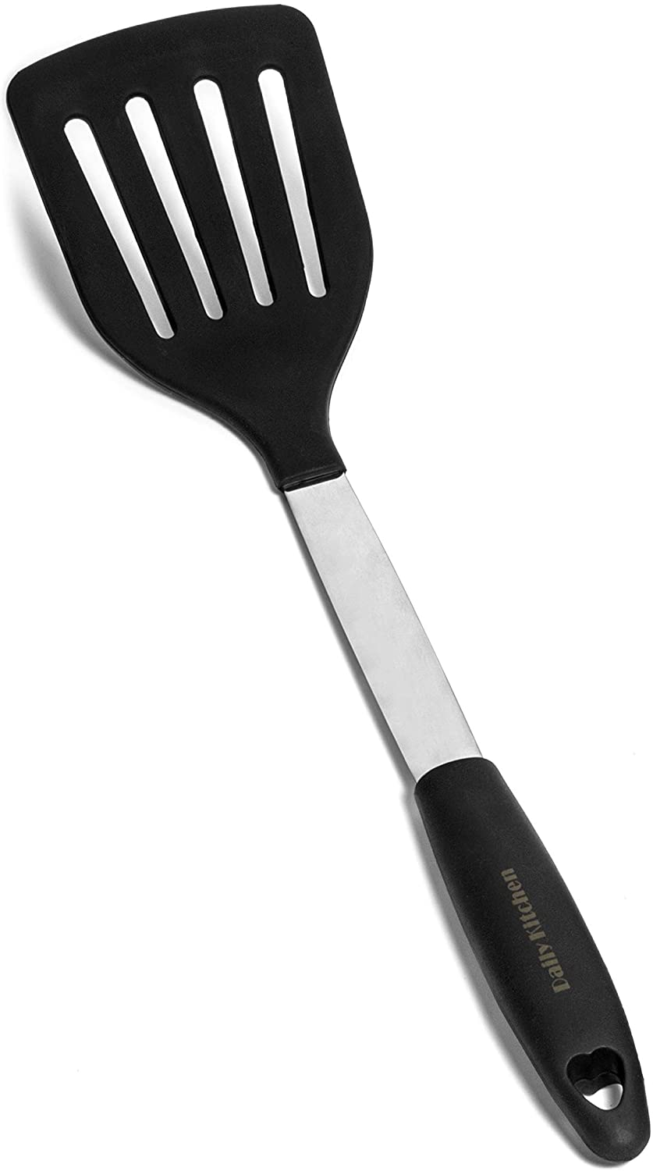
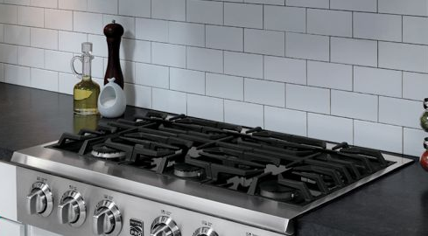
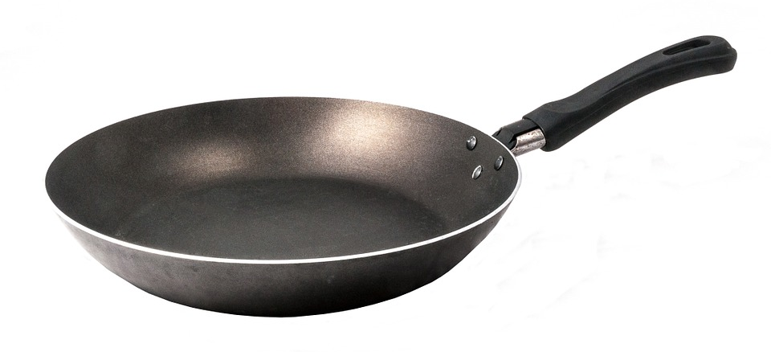
In the Kitchen 500 points
What do you need to cook an egg?

Slide 8
Staying Healthy 100 points
Germs and bacteria can live on your skin, in your hair, on your teeth, and on your clothes.
True
False

Slide 9
Staying Healthy 200 points
After you use the bathroom, what is the first thing you should do?

Slide 10
Staying Healthy 300 points
Give one good hygiene routine
Some Possible Answers:
Washing hands
Regular Showers
Brushing teeth daily
Change clothes daily

Slide 11
Staying Healthy 400 points
How long should you wash your hands?
2 seconds
20 seconds
5 minutes

Slide 12
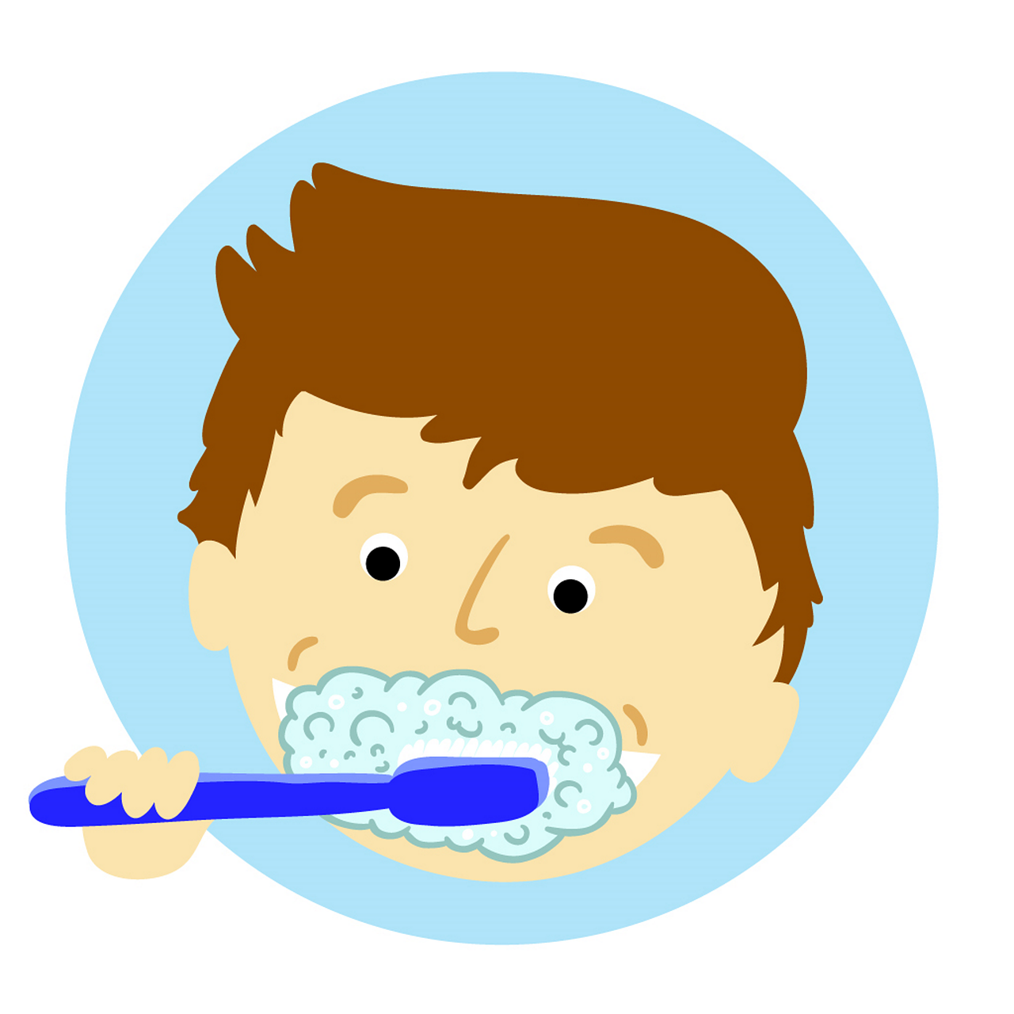
Staying Healthy 500 points
What is the recommended amount of times you should brush your teeth each day?
2 Times a Day

Slide 13
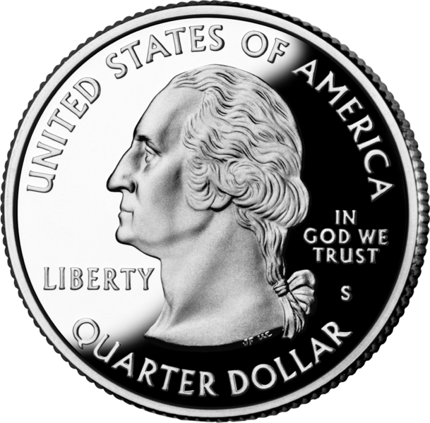
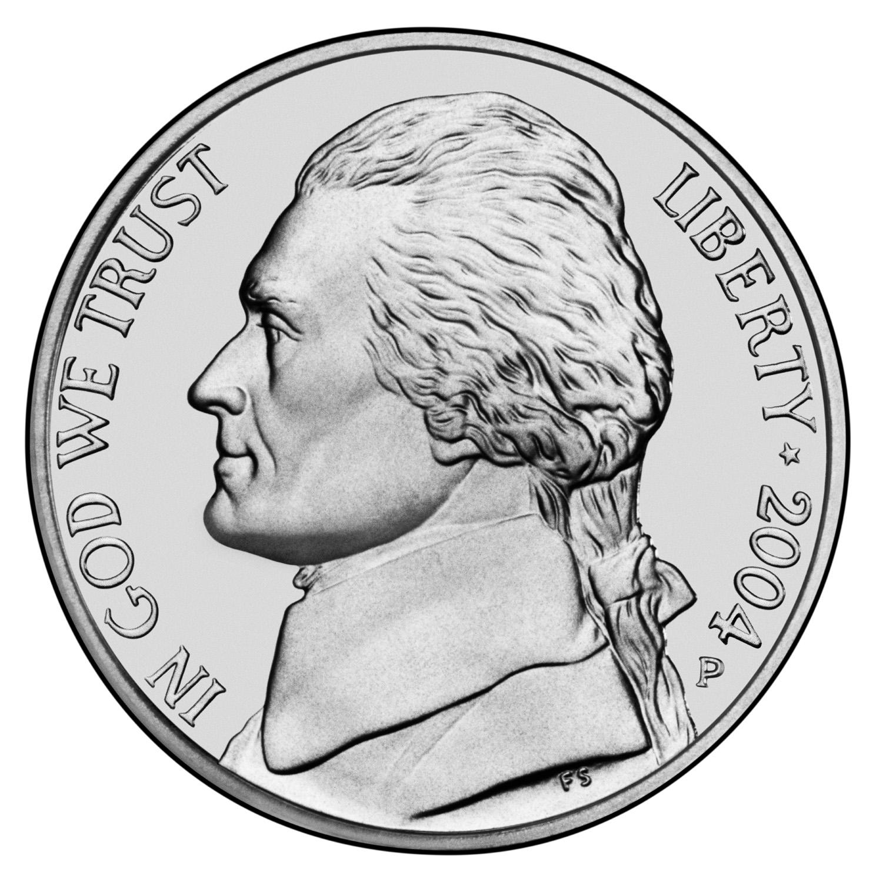
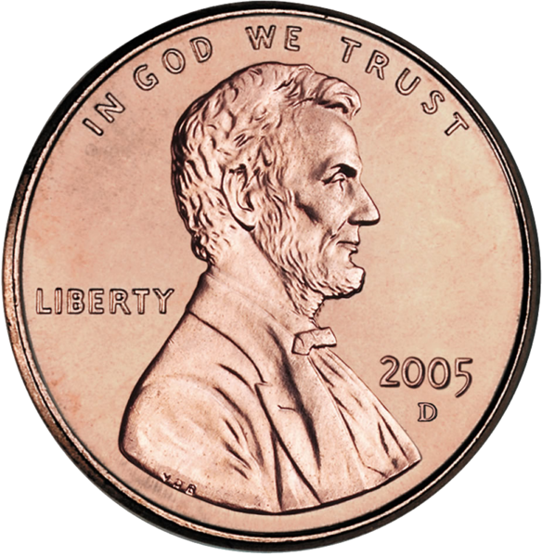
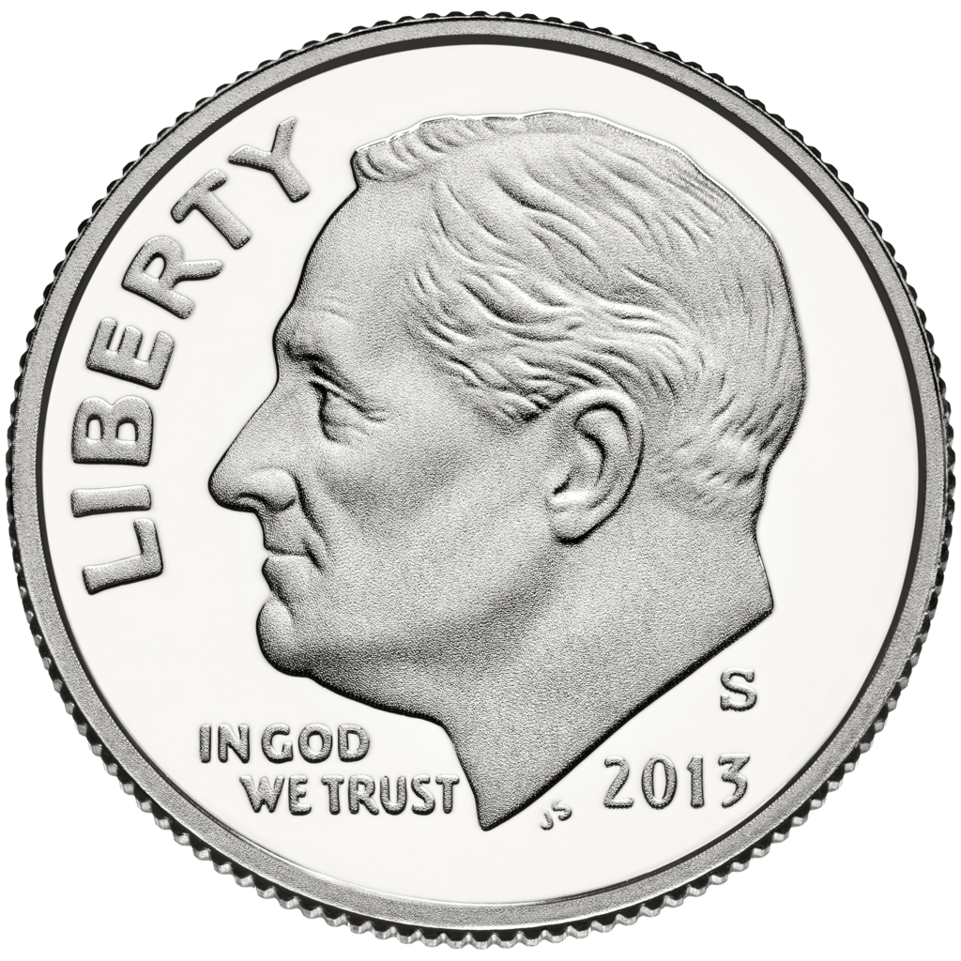
Money 100 points
What is the name and value of each coin?
Quarter
25 cents
Nickel
5 cents
Penny
1 cent
Dime
10 cents

Slide 14
Money 200 points
What is the next dollar up?
$26.34
$30.00

Slide 15
Money 300 points
What is one way to save money when grocery shopping?
Possible Answers:
Using coupons
Buying an on sale item
Buying store brand
Making a list and sticking to it

Slide 16
Money 400 points
Miranda went to the store and bought a jug of milk for $2.07 and a box of Raisin Bran cereal for $2.92. How much money did she spend?
$ 2. 0 7
$ 2. 9 2
+
$ 4. 9 9

Slide 17
Money 500 points
Rosie is throwing a birthday party for a friend. She spends $21.34 on decorations and $28.62 on food for the party. What is Rosie’s total?
$ 2 1. 3 4
$ 2 8. 6 2
+
$ 4 9. 9 6

Slide 18
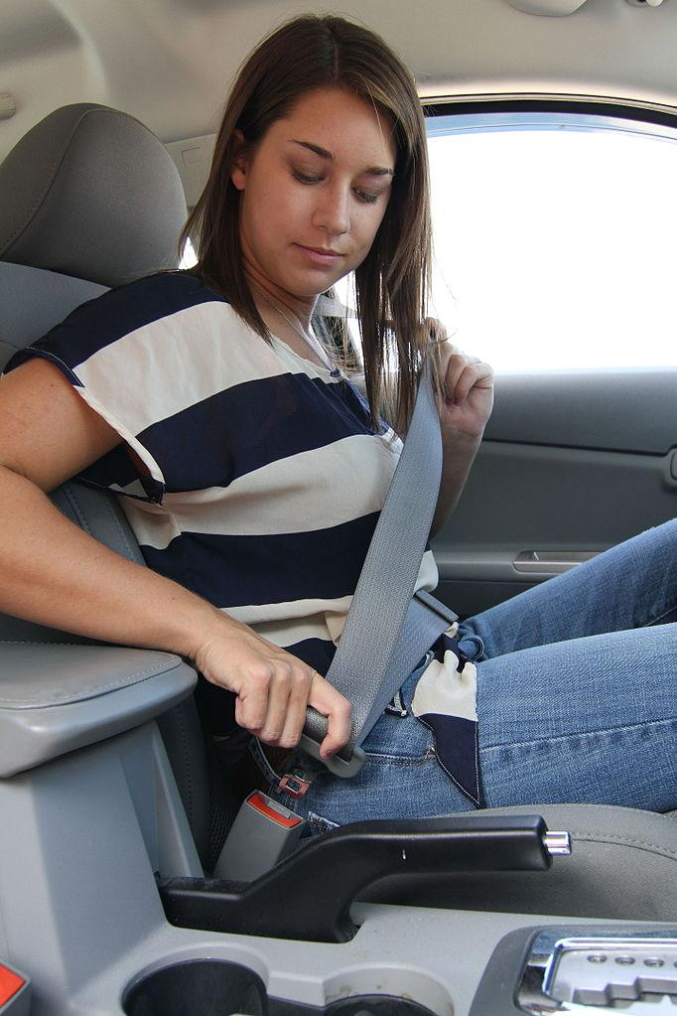
Out and About 100 points
What should you do this as soon as you get in a vehicle?
Put on your seatbelt!

Slide 19

Out and About 200 points
When crossing the street it is always important to do what?
Look both ways!

Slide 20
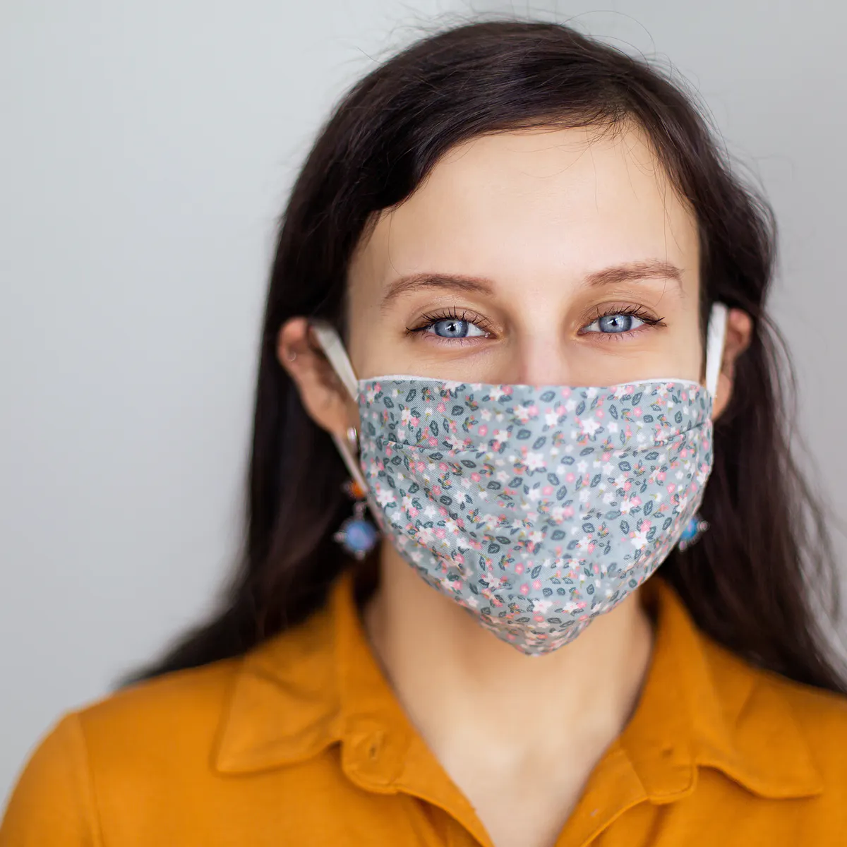
Out and About 300 points
What are you required to put on before entering a public place?
A mask!

Slide 21
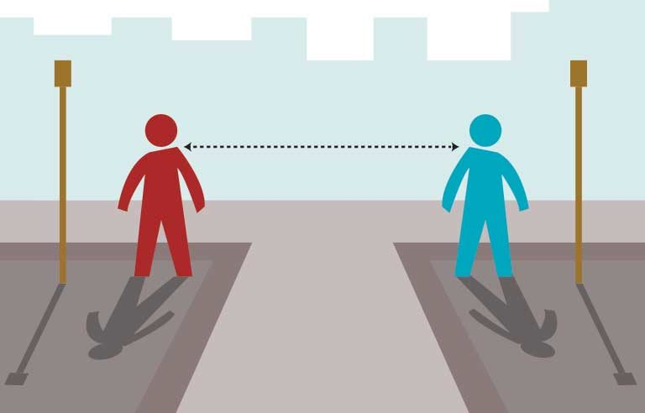
Out and About 400 points
How far away should you stay from people while out in the public?
6 feet

Slide 22
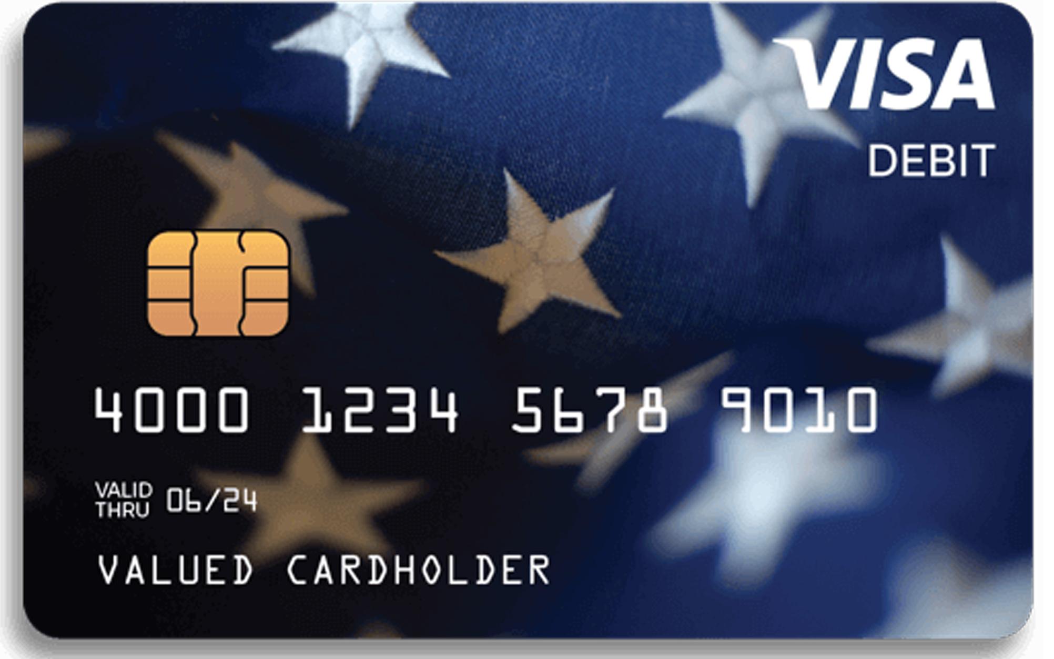
Out and About 500 points
What is the name of the card connected to your bank account?
Debit Card, Bank Card, ATM Card

Slide 23
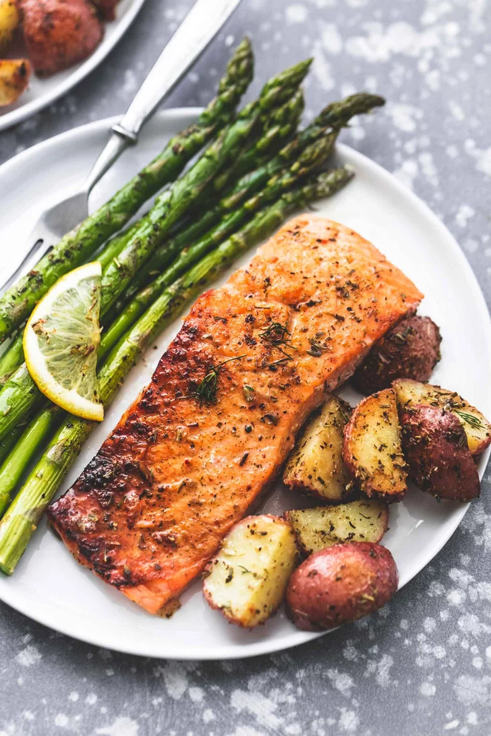
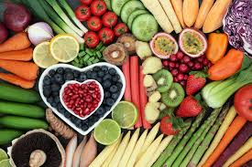
Healthy Living 100 points
Tell us about your favorite healthy meal

Slide 24
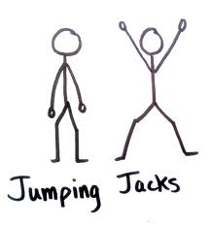
Healthy Living 200 points
Do 10 jumping jacks

Slide 25
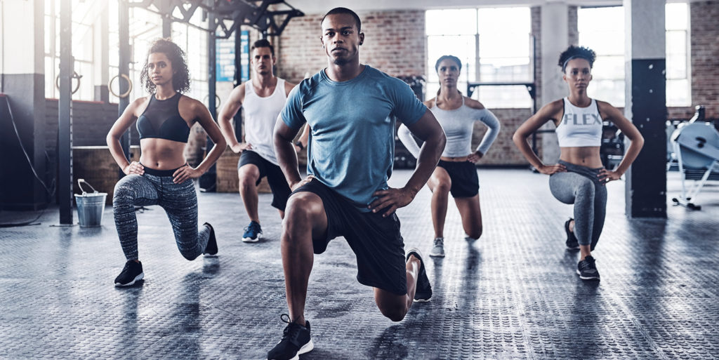
Healthy Living 300 points
Chose an exercise for everyone to do

Slide 26
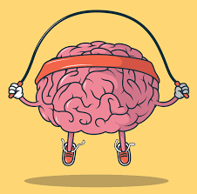
Healthy Living 400 points
What is one way you can keep your brain active?
Possible Answer:
Puzzles
Learn something new
Exercise
Teach a new skill to someone
Play cards or memory games

Slide 27
Healthy Living 500 points
What is one thing you can do when you feel stressed?
Possible Answers:
Go for a walk
Talk to someone
Color/ Create
Breathing exercises
Write in your journal

Slide 28
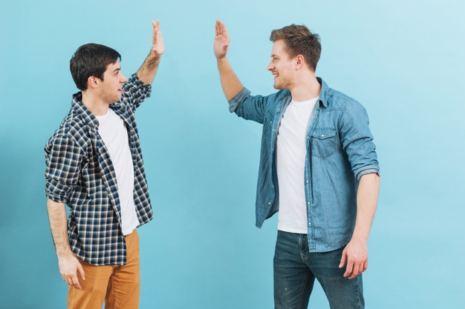
Friday Fun! 100 points
Give a compliment to a friend

Slide 29

Friday Fun! 200 points
What’s your favorite thing to do on the weekends?

Slide 30
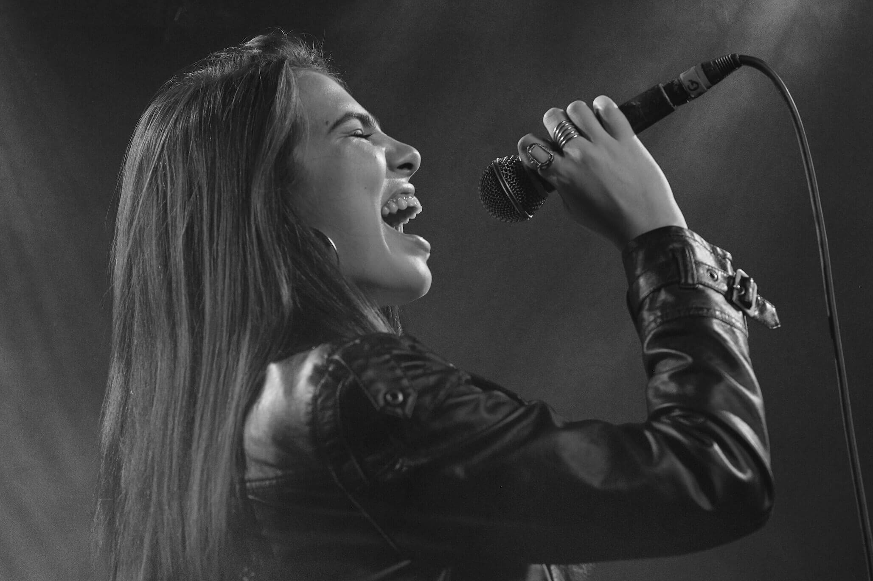
Friday Fun! 300 points
Sing us a song

Slide 31
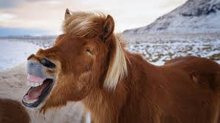
Friday Fun! 400 points
Tell us a joke

Slide 32
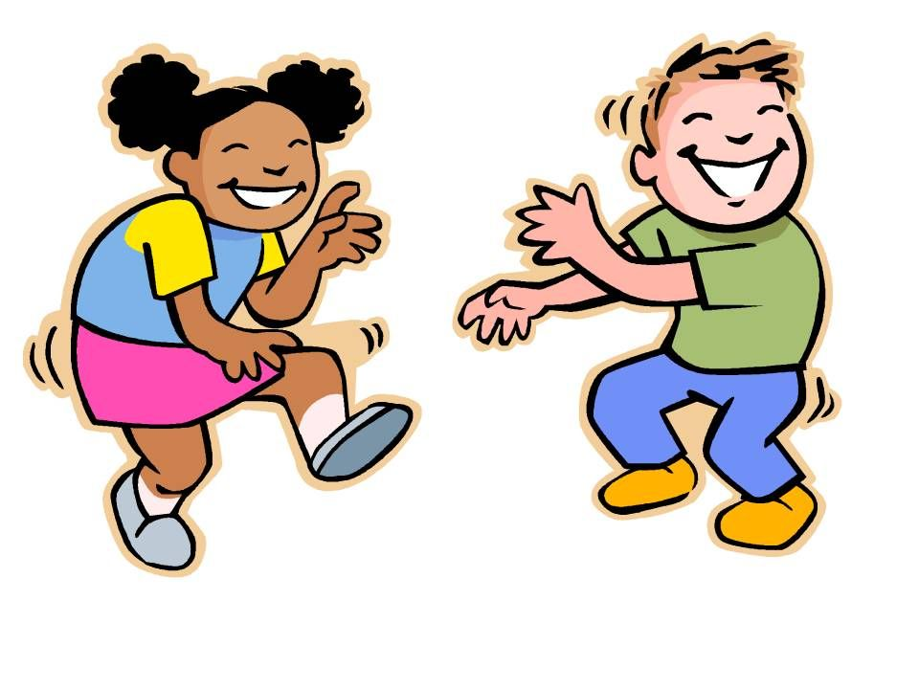
Friday Fun! 500 points
Show us your favorite dance move

