Slide 1
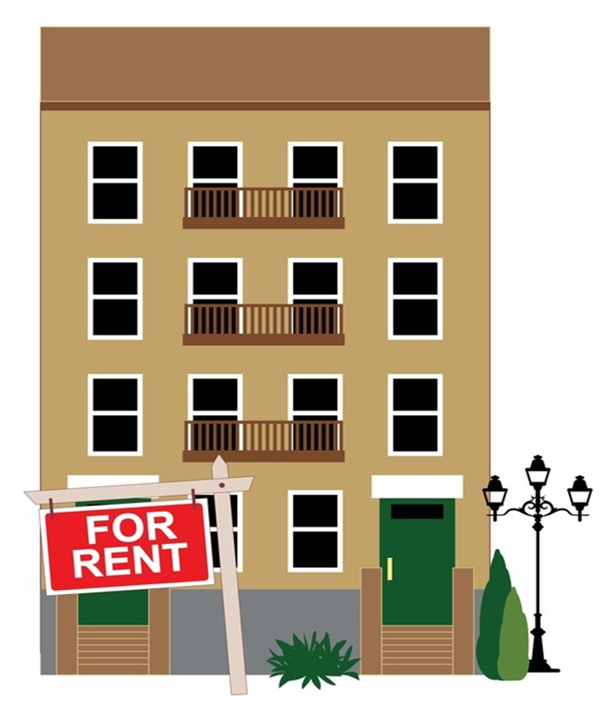
Living on Your Own Renting an Apartment
THE REQUIREMENTS TO RENT AN APARTMENT
SIGNING A RENTAL AGREEMENT OR LEASE
SELECTING THE RIGHT APARTMENT

Slide 2
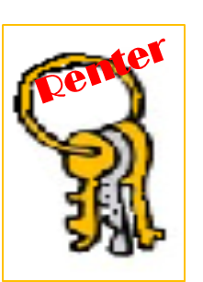
What is a TENANT and a LANDLORD?
TENANT
LANDLORD
The person that rents a room, apartment, or house.
The person that owns a room, apartment, or house and rents it to a person.

Slide 3
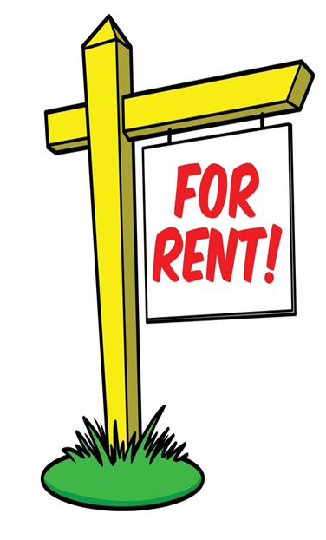
What is required to rent an apartment or room?
In order to rent a place, the landlord will most likely request :
Identification
References = A reference is someone that can vouch that you are responsible.
Permission to run a credit check = Credit check looks at your credit history to see if you have been responsible paying bills and borrowing money.
First month’s rent. (Sometimes a second month’s rent will be required as well . In some states it is illegal foe landlord to request a second month’s rent)
Security Deposit

Slide 4
What is a SECURITY DEPOSIT?
The Security Deposit = is money that the renter deposits with the landlord in case they damage the apartment or room.
If you damage something in the house, the security deposit will be used to pay for the damages.
If the renter doesn’t damage the house, the money is returned to the renter, when he or she moves out.

Slide 5
What is a RENTAL AGREEMENT or LEASE?
It is a written agreement between the renter and landlord.
The rental agreement is a legal contract, and you can be held
to all the conditions listed in the agreement once you sign it.
Under a contract you have an obligation (legally bound) to follow it.
It is very important to make sure to read the contract carefully before signing it. If you need to have someone look over the contract for you to help you understand it, then it is important to do so. Don’t be rushed into signing a rental agreement, wait until you fully understand it, including the fine print.

Slide 6
What is in a rental agreement?
Some of the key things in the contract are:
the amount of rent to be paid each month
when and whom the rent will be paid to
the length of the rental agreement
who pays for electricity and water
the rules you must follow
when and how you need to give notice if you decide to move
the repair policy
what appliances come with the apartment
if pets are allowed on the premise

Slide 7
What happens if you don’t follow the contract?
you may be required to vacate the apartment
and be responsible for any costs caused by early termination or related damages

Slide 8
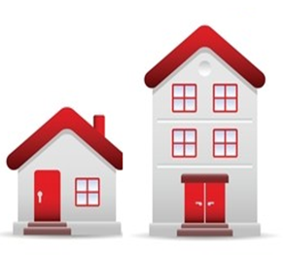
Selecting the Right Apartment
When it is time to look for a place of your own, it will be important to think about three things before selecting a place:
how much rent you can afford to pay
the location of the place
the type of place you need

Slide 9
How much rent you can afford to pay “Affordability”
1)
In order to make sure you can afford a place, financial experts recommended that the amount of rent you pay should not be more than 30% of your take home pay.
For example, if you bring home $3,000 after paying taxes, you could reasonably afford $1,000 a month in rent
Selecting the Right Apartment

Slide 10
Location, Location, Location
2)
It is a good idea to be close to your job.
If you can’t afford to be close to work or there is no housing close by, then it is important to make sure you are close to a transportation system that can get you to your job easily and quickly.
It is also important that you select a place that feels safe. Your safety should be a top concern when selecting a place.
Selecting the Right Apartment

Slide 11
The type of place you need.
3)
It is important to decide on what type of place you really need and not on what you necessarily want.
Some sacrifices may need to be made in order for you to find a place that is affordable and safe.
For instance, instead of renting a one-bedroom apartment it may be wise to a rent a studio, a room, or to have roommates.
Selecting the Right Apartment

Slide 12
Final Thought
It is important to make sure you understand any rental agreement that you sign. It is a contract which means you will be held responsible for following what is included in the contract.
In order to ensure you are successful when living on your own, it is important to make the following wise choices:
selecting an affordable place
choosing a good location
select a place based on your needs

