Slide 1
Applying for Medicaid Waivers
Presented by Julie Derringer, Case Manager,
Seven Counties- Developmental services division

Slide 2
Seven Counties Services- Community Mental Health Center
Seven Counties Services serves Bullitt, Henry, Jefferson, Oldham, Shelby, Spencer, and Trimble
1) Alcohol & Drug Addictions
2) Mental Health
3) Developmental Services
4) Bellewood & Brooklawn Campus Access & Referral- (855) 460-0990; www.bellewoodandbrooklawn.org
Seven Counties Services Access and Referral- (502) 589-1100; www.sevencounties.org

Slide 3
Developmental Services Division (DSD)
SERVICES PROVIDED….
1) Case Management for Michelle P Waiver, Supports for Community Living Waiver, & Acquired Brain Injury Waiver
2) Applied Behavior Analysis/Behavior Supports (Medicaid- Managed Care & Medicaid Waivers, private insurance)
3) Occupational & Speech Therapy (EPSDT [waiver clients less than 21 years], Medicaid- Managed Care & Medicaid Waivers (21+), private insurance)
4) Supported Employment (Work Matters)- OVR, Medicaid Waivers, State General Funds
5) Crisis Services- Case Management (stabilization & prevention), Respite, Development of Functional Assessment & Behavior Support Plan (M—F from 8:30 am to 5 pm call (502) 459-5292 and afterhours or on the weekend call our Crisis Line at (502) 589-4313.
6) Grant Based Services- Crusade iPad Grant
7) Family Support Services- Point of Entry for DSD; information & referral; waiver applications; Coordination and Referral for State General Funds ongoing services

Slide 4
State General Funds (SGF) Ongoing Services
Seven Counties is awarded State General Funds to provide ongoing services to clients who are in need of supports, but do not have any other funding source.
In order to access these services…
A client must have a DD/ID diagnosis.
A client must be on a waiting list for Michelle P Waiver and, if eligible, the Supports for Community Living Waiver. If a client meets eligibility (Level of Care/LOC) for the Home and Community Based Waiver, they must accept HCBW waiver services in order to use SGF for a non-duplicated service.
- Rule out that Medicaid, MCO, and/or private insurance will not cover the service. SGF must be the payor of last resort.
- The income of an adult client, or family income of a minor, cannot exceed 300% of poverty.
SGF services include: Adult Day Program/Adult Day Health Center, Behavior Supports, Community Access, Personal Assistance, Residential, Respite, and/or Miscellaneous Goods & Services

Slide 5
Kentucky Has 6 Medicaid Waivers
Acquired Brain Injury Waiver- Acute (ABI- Acute)
Acquired Brain Injury Waiver-Long Term (ABI Long Term)
Home and Community Based Waiver (HCBW)
Michelle P Waiver (MPW)
Model II Waiver
Supports for Community Living Waiver (SCL Waiver)

Slide 6
Acquired Brain Injury Waiver- Acute (ABI)
The ABI Waiver- Acute is for individuals who have a diagnosed traumatic brain injury and are 18 years of age or older. Clients with traumatic brain injury who are under the age of 18 could access services through the HCBW until they turn 18, at which time they can apply for the ABI- Acute and/or Long Term Waiver.
This waiver is for individuals who can benefit from intensive rehabilitation services. The services are designed to assist participants in re-entering the community and functioning independently.
This waiver does not have a waiting list.
Requires a RANCHO Score of 4 or higher. A completed MAP-10 is required. Hospital admission & discharge documents may be requested in addition to MRI and/or CT Scan reports.
For additional information about this waiver visit: https://chfs.ky.gov/agencies/dms/dca/Pages/abi.aspx

Slide 7
Acquired Brain Injury Waiver- Long Term (ABI Waiver- Long Term)
The ABI Waiver- Long Term is for individuals who have a diagnosed traumatic brain injury and are 18 years of age or older. Clients with traumatic brain injury who are under the age of 18 could access services through the HCBW until they turn 18, at which time they can apply for the ABI- Acute and/or Long Term Waiver.
This waiver is for individuals who have reached a plateau in their rehabilitation level. They require maintenance services to live safely in the community.
This waiver has a waiting list. Often, clients are placed on the waiting list for this waiver, but are able to access the Acute waiver or HCBW while they wait.
Requires a RANCHO Score of 4 or higher. A completed MAP-10 is required. Hospital admission & discharge documents may be requested in addition to MRI and/or CT Scan reports.
For additional information about this waiver visit: https://chfs.ky.gov/agencies/dms/dca/Pages/abi.aspx

Slide 8
Home and Community Based Waiver (HCBW)
The HCBW provides assistance to the elderly or to adults and children with physical disabilities to help them live in the community as independently as possible. Examples of diagnosis that may qualify an individual for HCBW are Epilepsy/Seizure Disorder, Atrial Septal Defect, Cerebral Palsy, Genetic Anomalies, and Diabetes. There have been times that a client may be reviewed and meet eligibility for the HCBW with only a diagnosis of Down Syndrome.
This waiver does not have a waiting list. A client who has a DD/ID diagnosis may access the HCBW while remaining on the MPW and/or SCL waiver.
Traditional Services, Person Directed Services and Blended Services are available through the HCBW.
Parents, grandparents, and siblings are generally excluded from being PDS providers. An exemption may be submitted to request permission for a “natural supports” to become PDS providers.
This waiver provides up to 40 hours of services based on need.
HCBW services include: Adult Day Health Care, Attendant Care, Environmental and Minor Home Adaptation, Home Delivered Meals, Non-Specialized and Specialized Respite Care, Goods and Services (i.e. incontinence supplies)
For additional information about this waiver visit: https://chfs.ky.gov/agencies/dms/dca/Pages/hcb-waiver.aspx

Slide 9
Michelle P Waiver (MPW)
The MPW provides assistance to individuals, children or adults, with intellectual or developmental disabilities to help them live in the community as independently as possible. Examples of a Developmental Disability are Autism, Down Syndrome, Cerebral Palsy, or a Genetic Anomaly. A Developmental Disability must be identified before the individual’s 22nd birthday. An Intellectual Disability is diagnosed when an individual has a FSIQ of 70 or less and significant impairments in Adaptive Functioning. An Intellectual Disability must be identified before the individual’s 18th birthday.
MPW has a waiting list. Our best estimate is that there are 7000+ individuals waiting for a MPW slot. This waiver does not have an emergency option.
Traditional Services, Person Directed Services and Blended Services are available through the MPW.
This waiver provides up to 40 hours of traditional services based on need. For PDS clients, a yearly budget is established not to exceed $40,000 of PDS services. For Blended Services, a yearly budget is established not to exceed $40,000 of PDS services and $23,000 of Traditional Services.
MPW services include: Behavioral Supports, Adult Day Training/Adult Day Health Center, Community Living Supports, Environmental and Minor Home Adaptation, Goods and Services, Personal Care, Respite, Supported Employment
For more information about this waiver visit: https://chfs.ky.gov/agencies/dms/dca/Pages/mpw.aspx

Slide 10
Model II Waiver (MIIW)
MIIW provides Medicaid-paid, in-home skilled services to individuals considered ventilator dependent per 907 KAR 1:022 and who, without MIIW services, would have to live in a hospital-based nursing facility.
This waiver does not have a waiting list.
Traditional services only.
For more information about this waiver visit: https://chfs.ky.gov/agencies/dms/provider/Pages/MIIW.aspx

Slide 11
Supports for Community Living (SCL) Waiver
The SCL waiver provides assistance to individuals, children and adults, with an intellectual or developmental disability to help them live in the community as independently as possible. Although this description is directly from the CHFS site on the SCL waiver (chfs.ky.gov/agencies/dms/dca/Pages/scl-waiver.aspx) it is known that ONLY individuals with an Intellectual Disability meet eligibility for this waiver. An Intellectual Disability is diagnosed when an individual has a FSIQ of 70 or less and significant impairments in Adaptive Functioning. An Intellectual Disability must be identified before the individual’s 18th birthday.
This waiver has a waiting list. There are 3 categories of placement for this waiver: Future Planning, Urgent, and Emergency. Currently, slots are only being awarded to individuals needing emergency services (individuals in crisis). Emergency is dictated by a need for 24 hour care with no caregiver available to provide supports.
Traditional Services, Person Directed Services and Blended Services are available through the SCL.
This waiver provides up to 16 hours of services per day. This is in addition to Residential services a client may receive.
SCL waiver services include: Adult Day Training/Adult Day Healthcare Center, Behavior Supports, Community Access, Goods & Services, Personal Assistance, Residential, Respite, Supported Employment

Slide 12
Traditional Services, Participant Directed Services (PDS), and Blended Services
Traditional services
PDS
You work with a Case Manager (CM) who will write a yearly Plan of Care, ensure that annual Assessments are completed, and will monitor other services. Depending on the waiver, CM will meet with the client and/or LG 1 or 2 times per month.
Your CM will make referrals to agencies who hire employees to provide waiver services to the individual
All services provided by a waiver qualify as traditional services.
You work with a CM/Broker who will write a yearly Plan of Care, ensure that annual Assessments are completed, and will monitor the annual budget or units. Depending on the waiver, CM will meet with the client and/or LG 1 or 2 times per month.
A Representative, chosen by the client/parent/LG, will be responsible for hiring, terminating, and training PDS staff. The Representative is also responsible for ensuring the employee meets employment criteria (i.e. background checks, CPR certifications) and that they are correctly documenting the time spent working with the individual. Representatives are not paid for their services.
Some waivers restrict who can be an employee. There is not limit to the amount of employees an individual may have. Hours are divided amongst employees. No employee can work more than 40 hours per week.
PDS services can be Attendant Care, Personal Care, CLS, Respite, and Personal Assistance.

Slide 13
Waiver Applications
There are several ways to apply for a Medicaid waiver:
1) A client/LG/parent can complete a waiver application on the kynect.ky.gov site.
2) Family Support Services staff at Seven Counties can assist with completing a waiver application for individuals who have a Developmental and/or Intellectual Disability
3) KIPDA (502-266-6084) can also assist with completing a waiver application. We direct individuals who do not have a DD/ID diagnosis to KIPDA.
There is only one waiver application for all waivers. The waiver for which a client is reviewed depends on how the Application Initiator answers 5 questions prior to completing the application and the questions on the waiver application. The Application Initiator cannot select for which waiver they want the individual to be reviewed.

Slide 14
What do you need to apply for a Medicaid Waiver?
1) An active Medicaid case
or
2) A Medicaid application needs to be submitted, even if it is denied. If you contact SCS for assistance with completing a waiver application, the CM may be able to tell you if we can access a Medicaid dashboard for the individual for which we will be applying. If we cannot access the Medicaid dashboard, even if you have applied for Medicaid, the CM will request that you apply again. You can apply for Medicaid at kynect.ky.gov or by calling 855-306-8959.
…

Slide 15
What do you need to apply for a Medicaid Waiver? (continued)
2) Proof of Disability- This may be a Psychological Evaluation report from a private psychologist or agencies such as Weisskopf, Bingham, or OLOP. Often, we can also use an Integrated Assessment Report from a local school district, if it contains diagnostic information (i.e. FSIQ & Adaptive Functioning Assessment, Autism Diagnosis). If the individual is less than 3 years old and in First Steps, we have used the 5 Area Assessment.
For a diagnosis of Down Syndrome it is helpful to have a copy of the genetic testing report, PCP progress note or other medical documentation that confirms the diagnosis, or a MAP-10.
Specifically for consideration for the SCL waiver, the waiver Application Reviewer will often request the use of the following tests for diagnosing Intellectual Disability: Weschler Adult Intelligence Scale (WAIS), Weschler Intelligence Scale for Children, Stanford Binet, or Woodcock Johnson for a FSIQ and the Vineland or Adaptive Behavior Assessment System (ABAS) for an adaptive assessment score. If applying for an ER SCL waiver slot, the adaptive testing must be within the past 2 years.
If psychological testing has not been completed or the documentation available does not contain the information we need to apply for a waiver, we can refer the individual for psychological testing.

Slide 16
What do you need to apply for a Medicaid Waiver? (continued)
3) MAP-10- A MAP-10 is State form used to verify diagnosis(es) and is required for an individual to be considered for the HCBW. The form must be completed by a PCP (MD) or Specialist. The box indicating “HCBW” must be marked. Other waivers can be marked, as well.
This document is only valid for 60 days. We may ask you to hold off on obtaining it until we have a date scheduled to complete the waiver application. We can also request it on your behalf if you have given us consent to obtain and share information with the doctor from whom will be requesting the form.
A copy of the MAP-10 can be found at https://chfs.ky.gov/agencies/dms/MAPForms/Map10.pdf

Slide 17
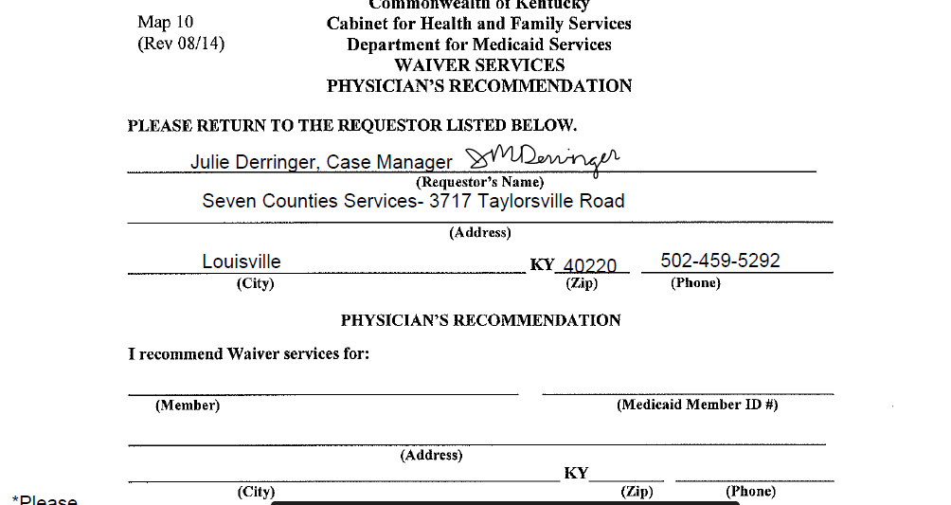
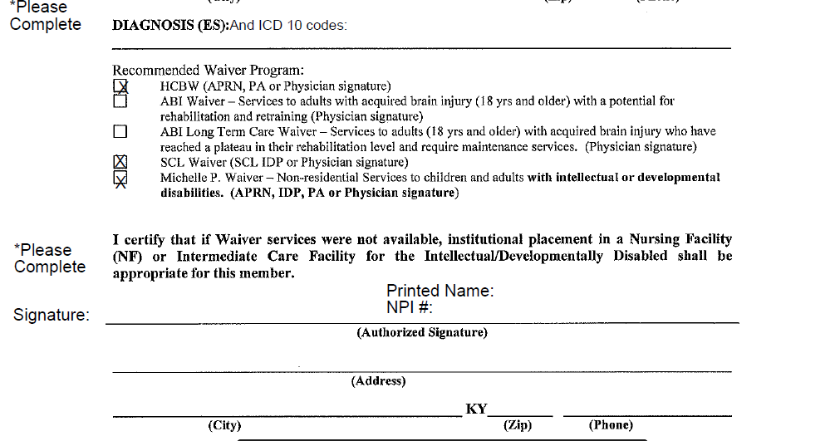
Copy of MAP-10

Slide 18
What can you expect if you call SCS/DSD/FSS for assistance with submitting a waiver application….
1) Call (502) 459-5292 and ask to speak with the Family Support Services person on-call. Inform the CM that you would like assistance with applying for a Medicaid waiver. You will be asked if the individual has Medicaid and you will be asked to supply a copy of the Proof of Disability. A scanned copy of the documents can be emailed directly to the CM. If you are interested in applying for the HCBW, the CM will discuss the MAP-10 and provide a copy of the form if you do not have one. They will take demographic information, income information, and diagnostic information in order to open an electronic medical record for the individual.
2) Once Proof of Disability is received and reviewed, a CM will contact you to schedule a time to complete the waiver application. Currently, these are done by phone or zoom. In the past, and likely in the future, we will complete these applications via a face to face meeting. They will also email or mail SCS documents that need to be reviewed and signed. If you are comfortable providing verbal consent, they may review the forms with you over the phone.

Slide 19
What can you expect if you call SCS/DSD/FSS for assistance with submitting a waiver application….
3) A CM will call, or meet with you via zoom, to complete a waiver application. The CM will only complete the waiver application if they have received signed SCS documents, proof of disability, and a MAP-10 (if we are requesting review by the HCBW).
4) The waiver application is completed on the MWMA (Medicaid Waiver Management Application) system which is accessed through the individual’s Medicaid dashboard. Supporting documents are uploaded with the application.
5) The application and supporting documents are reviewed by a Waiver Reviewer and the Reviewer determines for which waiver(s) the individual will be considered.
For an individual with a diagnosis of Down Syndrome, they will likely be added to the MPW waiting list. If the individual also has a diagnosis of Intellectual Disability, they will likely be added to the SCL waiver waiting list. If the individual has a medical/physical disability, the application may be reviewed for consideration for the HCBW. A diagnosis of Down Syndrome without any other diagnosis may lead to review for the HCBW, if the MAP-10 submitted is marked “HCBW.”

Slide 20
What happens if the individual is reviewed for the HCBW?
If an individual is reviewed by HCBW, they may be determined to not meet initial criteria for assessment. If initial criteria for assessment is met, the individual will be placed in que for a Level of Care Assessment.
Currently, LOC assessments are being completed by phone with the individual, parent, caregiver and/or LG.
If the individual does not meet the LOC for the waiver after the assessment, the case will be closed. If the individual meets the Level of Care for the HCBW, they will either be enrolled in the program or they will remain in a “pending Medicaid eligibility for waiver enrollment” status.
Enrollment in HCBW means that the individual has the correct type of Medicaid to use waiver services. The individual’s former Medicaid coverage with a Managed Care Organization (MCO) will end and they will transition to “straight” or “waiver” Medicaid coverage. In many cases, this will not cause any disruption in coverage. However, common disruptions may be to coverage/delivery of incontinence supplies, medication that requires prior authorization, and in some cases, PCP/specialist services. This change in coverage occurs at enrollment for all waivers.

Slide 21
What happens if the individual is reviewed for the HCBW?
If a client is “pending Medicaid eligibility for waiver enrollment,” it means that you will have to apply for Medicaid…. AGAIN.
If an individual was denied Medicaid, it is likely because they are a minor and the family income exceeds the Medicaid limits. When you apply for Medicaid after the LOC for the HCBW is met the Medicaid should be approved. You may have to provide proof that you have applied for SSA benefits (SSI) and have been denied. The CHFS will review the case using a Medical Review Team to determine disability and if disability is established, Medicaid will be approved. Once Medicaid is approved- it could take a couple months- the enrollment in the waiver will take place.
Once a client is enrolled in HCBW, contact a CM agency who will assist you with establishing services. If you intend to use PDS or blended services, contact KIPDA (502- 266-2084). If you intend to use traditional services, you can contact one of the other HCBW CM agencies in our region. The SCS CM will provide some suggestions.
An individual can maintain their private insurance as primary and Medicaid will become the secondary insurer. Medicaid will pay for copays, coinsurance and deductibles. KI-HIPP is a program that can help pay for your employer sponsored insurance premiums. For information about this program call 855-459-6328 or visit kihipp.program@ky.gov.

Slide 22
A Note about Social Security benefits
a) If the individual is receiving SSI, mostly likely the individual is already receiving or qualified for Medicaid.
b) If the individual applied for SSI but was denied due to family income (for a child), find the denial letter or reapply. If it’s been a while since the denial was given, reapply and get a more current denial letter. The denial letter will help the individual’s case get passed on to a Medical Review Team (MRT) at DCBS and an MRT will determine if the individual is disabled. This is a necessary piece before the individual is awarded Medicaid. The number to SSA is (800) 772-1213.
c) If the individual is an adult and receives SSDI (likely have Medicare), applying for Medicaid with DCBS is needed. The individual may already have QMB (Qualified Medical Benefit) Medicaid that pays Medicare premiums. This type of Medicaid is not Waiver Medicaid and will not pay for waiver services. A call to DCBS to request Waiver Medicaid is needed.
d) If the individual is an adult and was denied SS benefits, it is unlikely they will be able to receive the type of Medicaid needed for a Medicaid waiver. A denial is given either because the client does not have a disability as determined by the SSA or sufficient information to establish disability has not been provided. A denial may also be given if the individual’s assets exceed the income limits. This may require placement of assets in a Special Needs Trust.

Slide 23
About the MPW and SCL Waiver waiting lists….
You will receive a letter from the MPW program, yearly, that asks if there are any changes to the individual’s address or phone number. It also asks if the individual wants to be removed from the waiting list. Unless there are any updates to demographic information or you want the individual removed from the waiting list, you do not have to return the letter. Please read it thoroughly as the letter may change. If there are changes to the address in between letters, please contact Medicaid to update the address. If the individual does not have an active Medicaid case, contact the MPW program to update the address. The number is (502) 564- 1647.
To find out where an individual is on the MPW waiting list, you can also call the MPW program at (502) 564-1647.
When a slot becomes available in the MPW waiver, you will be mailed a certified letter. This means you will have to sign for it. If you are not home to receive the letter, the mail carrier should leave a brown slip in your mailbox saying you need to pick up the letter at the post office. PLEASE DO NOT IGNORE THIS LETTER. It is time sensitive as the State only gives a 45 day window for MPW assessments to be completed. If you miss the window, the individual will have to be added to the bottom of the MPW waiting list. There are no exceptions. Currently, the letter tells you to call your local CMHC to schedule the assessment. You would contact our office and we will assist you with getting the assessment scheduled. The number is (502) 459-5292.

Slide 24
About the MPW and SCL Waiver waiting lists….
The SCL waiver also mails a letter, yearly, to ask if you want the individual to remain on the SCL waiver waiting list. The letter MUST BE RETURNED if the individual is to remain on the waiting list. Please be looking out for this letter and return it within the month timeframe that is given.
As mentioned earlier, at this time, only Emergency slots are being awarded for the SCL waiver. If the individual is experiencing an emergency and requires residential supports that can only be provided by the SCL waiver, please contact our office for assistance with completing an ER SCL Request. If you have an HCBW or MPW Case Manager at the time of the emergency, the HCBW or MPW CM will have to submit the ER SCL Request on your behalf. However, our CM’s are very experienced with submitting the ER SCL Requests and we are able to assist the HCBW/MPW CM with the process of submitting the ER SCL request.

Slide 25
Questions?????

