Slide 1


Developing Responsibility:
Learning job skills and work ethic at home.

Slide 2
Program:
1.Introduction
2.Why work is important.
3.How we work together.
4.Ideas for getting started.

Slide 3



Career Solutions
We provide customized employment.

Slide 4
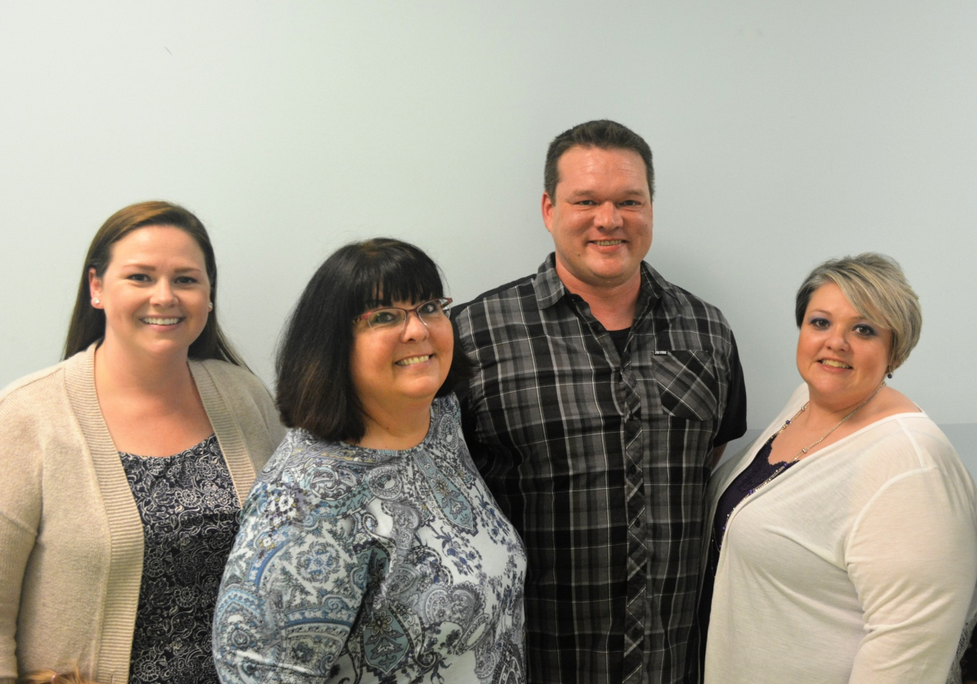

Slide 5
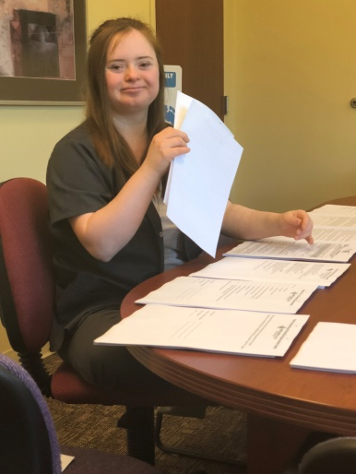
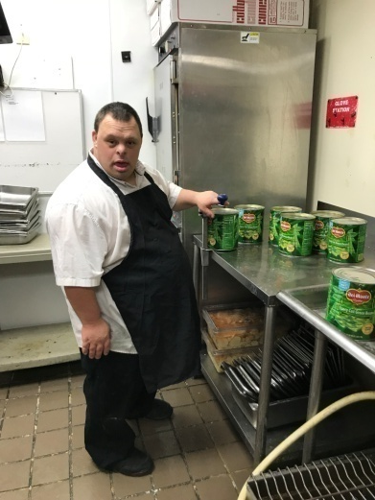
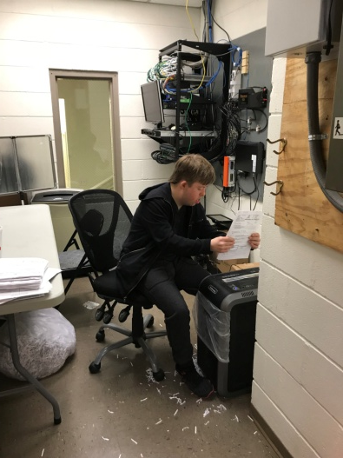
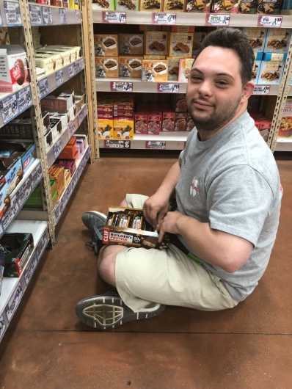
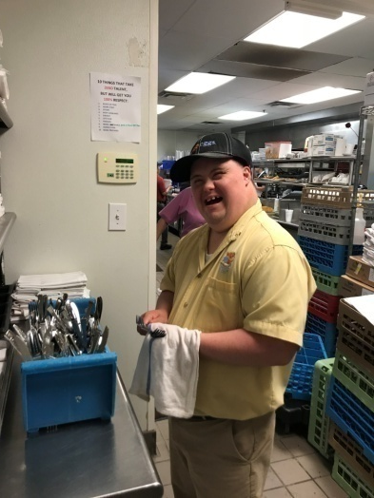
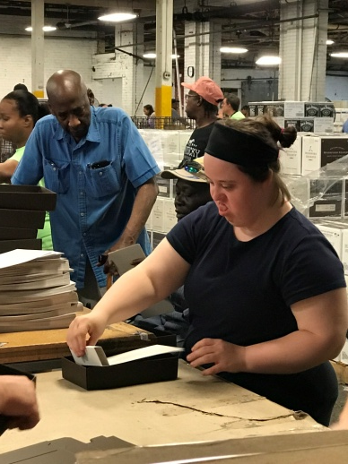
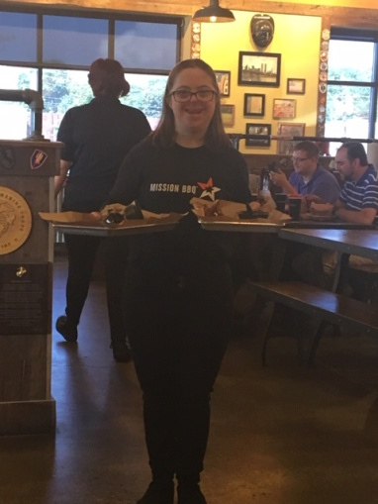
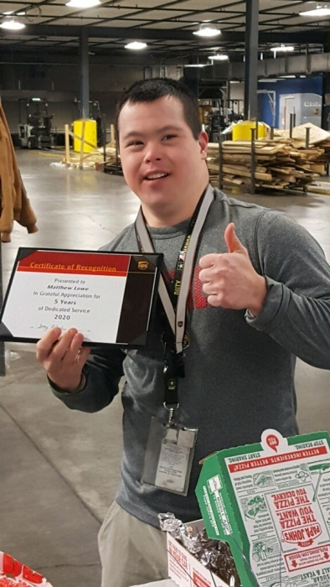
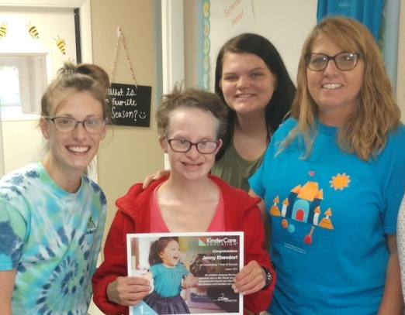
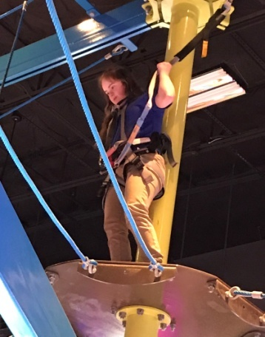
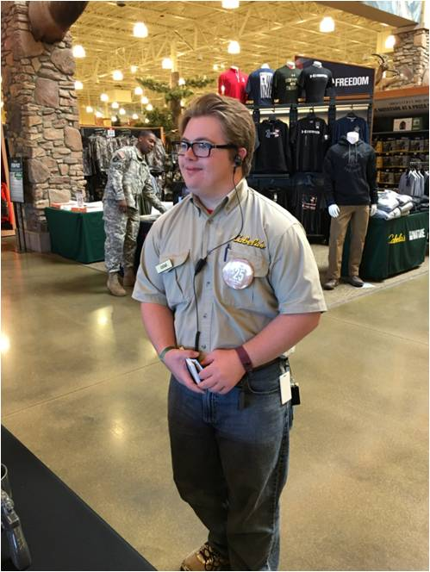


Slide 6
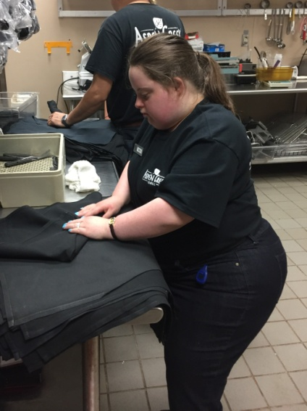
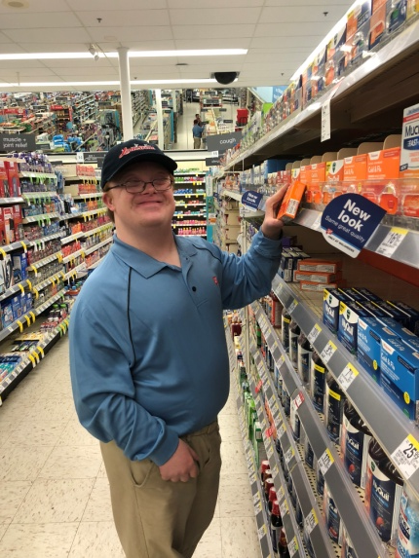
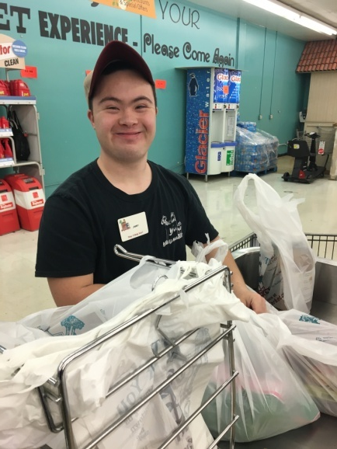
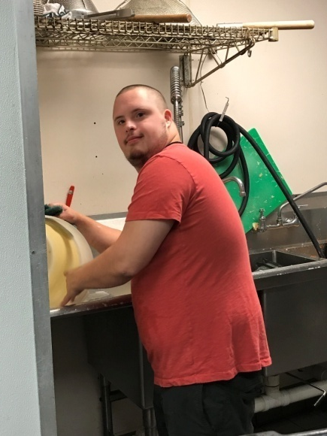
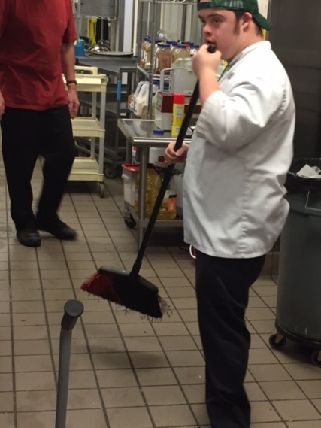
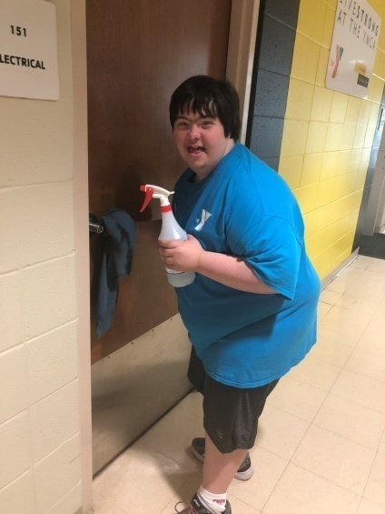
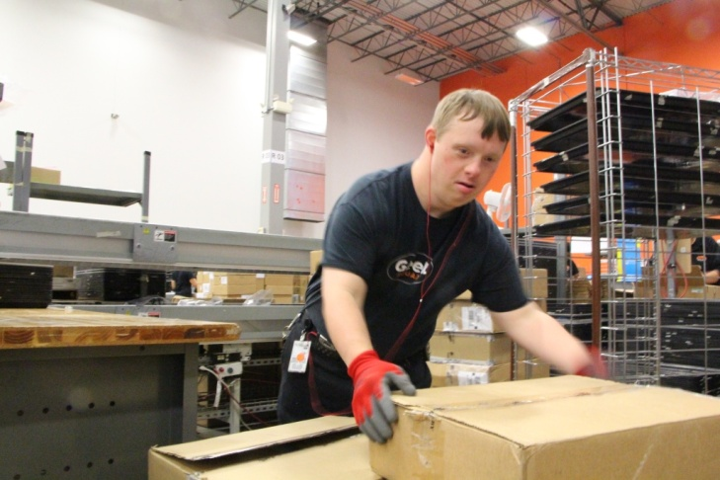
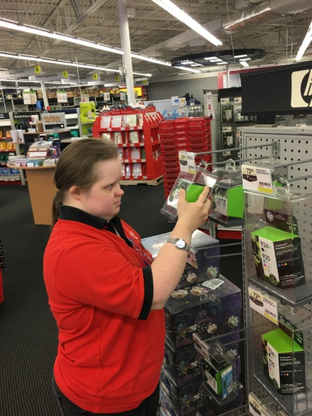
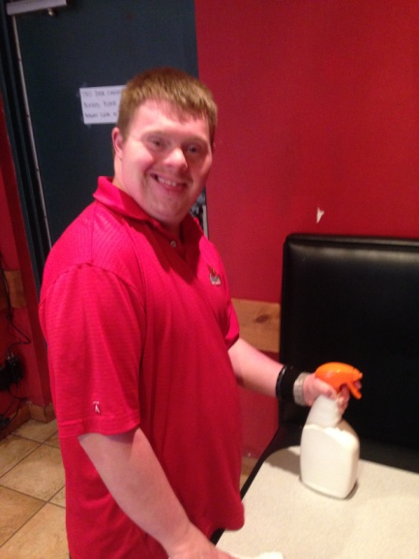
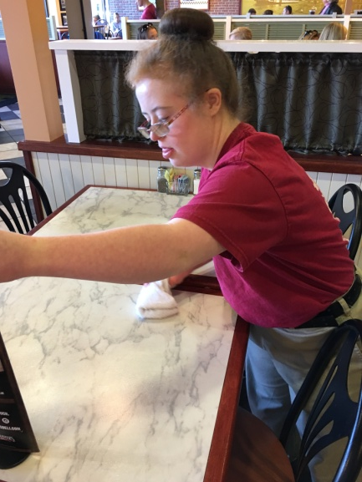
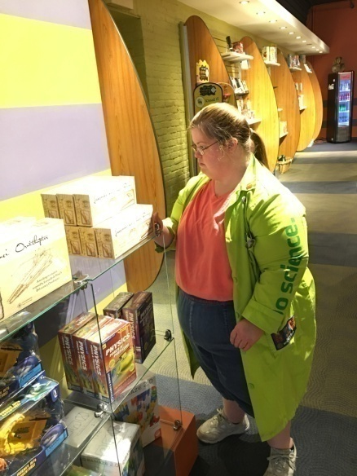

Slide 7
Why does employment matter?
1. Independence in the community.
Making a contribution to society.
Advocating for one’s self.

Slide 8
Why does employment matter?
4. Earn your own money.
5. Make new friends.
6. Develop confidence and additional skills.

Slide 9
After school…
Usually we meet people right after high school or whatever vocational training they may have.

Slide 10
After school…
A variety of factors will influence their job readiness: speech, coordination, reading, number recognition, handling money…

Slide 11
But most of all…
Chores! An individual who works at home and already has an established work ethic will always do better than those who don’t.

Slide 12
Parent interview
Margarita Edelen

Slide 13
Can we even do chores?
What happens to our expectations?

Slide 14
“The Dream”
How do our expectations for someone’s life change if they are born with a disability? Why is that?

Slide 15

How we see our members…
Do we see an “eternal child” or a “holy innocent?”
Or do we see a capable person who is going to have a full life?

Slide 16
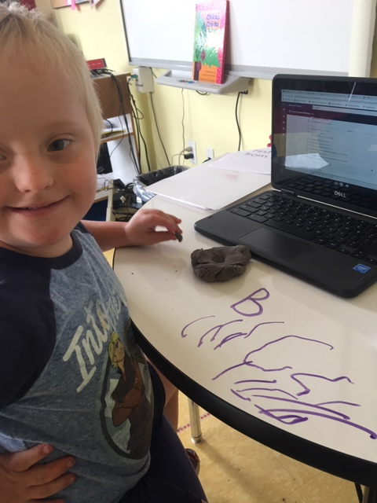
Focus on what we CAN do.

Slide 17
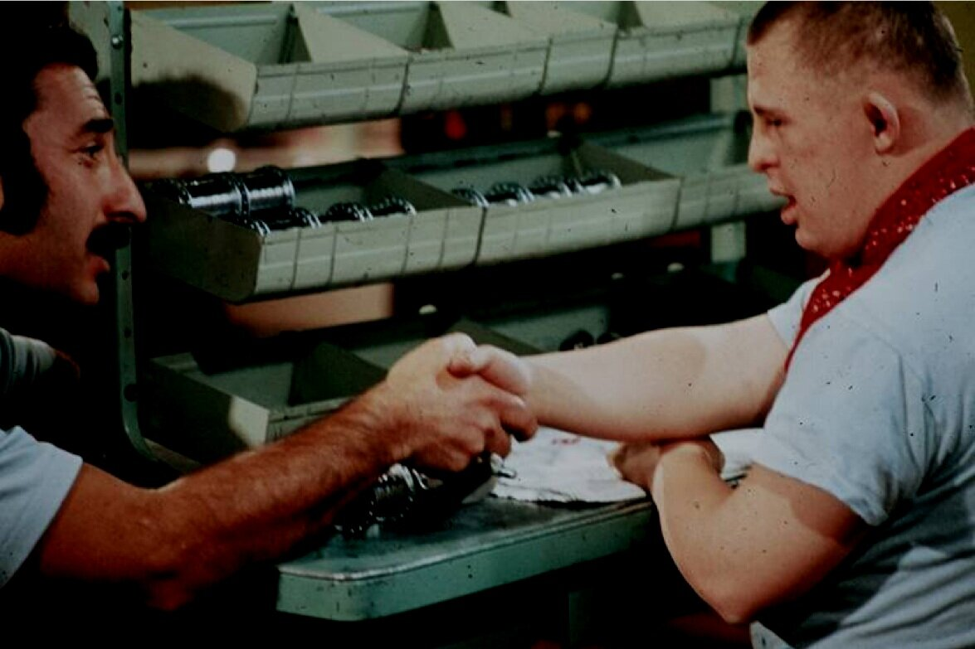
“Train, don’t teach.”
“… don’t assess vocational skill levels. That’s a waste of your time and the time of the person that you serve; train the person to do a job.”
-Marc Gold

Slide 18
Chores at home = Job training
If we are only as good as our training, and our training starts at home….
The work that we do or don’t do at home is the foundation for an individual’s work readiness. We have seen that this has a major impact on what kind of job a person can get.

Slide 19
The benefits of doing chores…
They’ll believe they’re capable.
Learn about consequences.
Learn the responsibility of taking care of one’s self.
Develop empathy from taking care of another.
Build self-esteem.
Learn problem solving skills.

Slide 20
The benefits of doing chores…
Delayed gratification and a sense of pride.
Learn about family and community.
Support motor development.
Create opportunities for connection.
-Katie Brown with Gabby Mullen
https://redtri.com/life-skills-learned-from-doing-chores

Slide 21
The benefits of doing chores…
Learn what you actually enjoy doing.
Develop work ethic… the ability to do a task.
Grow through early behaviors.

Slide 22
How do we get started?
“How to get your kids to do
chores without resenting it.” – Michaeleen Doucleff, NPR
https://www.npr.org/sections/goatsandsoda/2018/06/09/616928895/how-to-get-your-kids-to-do-chores-without-resenting-it

Slide 23
“How to get your kids to do chores without resenting it.”
Psychologists noticed in rural Mexican and
South American communities how
the children would talk about the chores
that they did.

Slide 24
“How to get your kids to do chores without resenting it.”
“I wash my own clothes!” – 7 year old
“I wash my clothes and my baby brother’s
clothes!” – 9 year old
Vallodolid, Yucatan

Slide 25
“How to get your kids to do chores without resenting it.”
“Many times the children would ask to do
work around the house.”
-Suzanne Gaskins Northeastern Illinois University
This is all without gold stars, allowance,
or any other manner of incentive.

Slide 26
“How to get your kids to do chores without resenting it.”
It was common to see the children working
in unison with the adults, dividing
responsibilities so that all of the work in
the house was complete.
The families use the term: acomedido

Slide 27
“How to get your kids to do chores without resenting it.”
“It’s really a complex term…. It’s not just
doing what you’re told, and it’s not just
helping out. It’s knowing the kind of help
that is situationally appropriate because
you’re paying attention.”
-Andrew Coppens University of New Hampshire

Slide 28
“How to get your kids to do chores without resenting it.”
What are these families doing differently?
Most of the researchers say: embrace the
power of toddlers, who are eager to help
and be a part of what their parents are
doing.

Slide 29
“How to get your kids to do chores without resenting it.”
“Toddlers are very eager to be helpful.”
-David Lancy Utah State University
“Children appear to have an intrinsic
motivation to help, and extrinsic rewards
seem to undermine it.”
- Felix Warneken & Michael Tomasello

Slide 30
“How to get your kids to do chores without resenting it.”
“Doing things with other people makes
them happy and is important for their
emotional development. They see what
their mom or siblings are doing, and they
want to do it.”
- Rebeca Mejia-Arauz ITESO University, Guadalajara

Slide 31
“How to get your kids to do chores without resenting it.”
While toddlers are willing to help, we
acknowledge that they are messy, and
won’t be able to do a lot on their own…
But instead of focusing on what they can’t
do, what can they do?

Slide 32
“How to get your kids to do chores without resenting it.”
“We have mothers tell us things like ‘I
need to do this chore very quickly, and if
my toddler tries to help, he makes a mess.
So I’d rather do it myself than have them
helping.”
- Rebeca Mejia-Arauz ITESO University, Guadalajara

Slide 33
“How to get your kids to do chores without resenting it.”
The rural families that these psychologists
were studying tried to expose their toddlers
to as many chores as possible.
“They invite them over by saying
something like: ‘Come, my child, and help
while I wash the dishes’.”
- Rebeca Mejia-Arauz ITESO University, Guadalajara

Slide 34
“How to get your kids to do chores without resenting it.”
“For example, one mom told us: ‘When my toddler
was doing the dishes, at the beginning, the water
was all over the place, but I would allow my son to
the dishes because that is how he learned.”
- Rebeca Mejia-Arauz ITESO University, Guadaljara

Slide 35
“How to get your kids to do chores without resenting it.”
“Early opportunities to collaborate with parents
likely sets off a developmental trajectory that leads
to children voluntarily helping at home.”
- Andrew Coppens University of New Hampshire
Conversely, if a child is told that they are not
involved in an activity, they will believe you.

Slide 36
“How to get your kids to do chores without resenting it.”
Question: This is a completely different culture.
Does this even apply to us?
“…replicating this approach isn’t easy. It’s not a
slam dunk. We have to slow down what we are
doing. We have to make allowances.”
Andrew Coppens, University of New Hampshire

Slide 37
“How to get your kids to do chores without resenting it.”
Other Examples: Amish and Mennonite
Communities.
Families living in agricultural communities.
“Hunter the 4th grader” example.

Slide 38
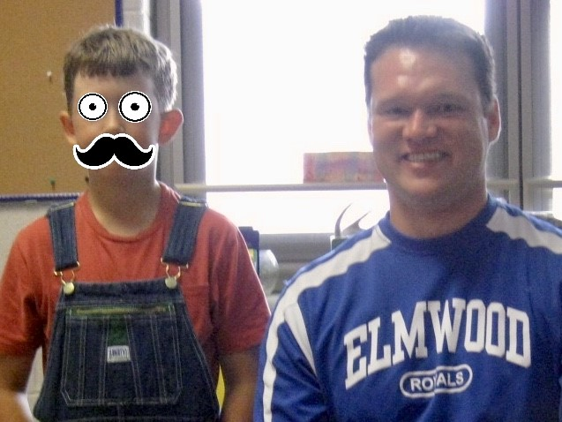
“How to get your kids to do chores without resenting it.”

Slide 39
“How to get your kids to do chores without resenting it.”
Great, so how do we go about doing this?

Slide 40
“How to get your kids to do chores without resenting it.”
1. Expose kids to chores as much as possible.
“Especially during the early years, give children the
opportunity to wander over and watch what is
happening with adults. You’ll be surprised how
much toddlers can learn by simply observing what
you do – no lecturing or explaining necessary.”
Andrew Coppens, University of New Hampshire

Slide 41
“How to get your kids to do chores without resenting it.”
2. Think small tasks, big contributions.
Offer opportunities for the child to help with the chore
you’re doing. Give them a task that is appropriate for
their skill level. Maybe it’s holding a measuring cup
while baking, moving a chair while sweeping, or drying a
dish or two.
Avoid having them do “mock work”.

Slide 42
“How to get your kids to do chores without resenting it.”
3. Always aim to work together.
A big motivating factor for children is being around the
family, working on a common goal. This motivation is
lost if we divide up chores so everyone is working solo.
Example: If you’re folding laundry, make sure that
everyone is folding everyone’s laundry.

Slide 43
“How to get your kids to do chores without resenting it.”
4. Don’t force it.
“Just like adults, kids don’t like being bossed around.
Asking a little kid, ‘Could you help me with this?’ often
gets them on board more than simply saying, ‘You must
do this’.”
Barbara Rogoff Cal State

Slide 44
“How to get your kids to do chores without resenting it.”
5. Change your mindset about young children.
“All parents are interested in supporting their kids… if
you make the assumption the toddler wants to help you,
but he just doesn’t have a good understanding of how to
do that – then you’ll try to find a way for him to help.
You’ll help him help.”
Andrew Coppens, University of New Hampshire

Slide 45
“ASHA LEADER”
Becca Eisenberg, is an author that writes an article called ASHA Leader. In this article she states, “that she has worked with several older children and adults with development disabilities without any experience in vocational skills. She goes on to say that individuals can complete these tasks, but lack the experience to.” She expresses that many individuals have not had the “encouragement at home to learn basic chores.”

Slide 46
“ASHA LEADER”
Eisenberg gives a list of five chores to try at home with your children…
Laundry- categorization, following directions, literacy(reading words in the care tags), math skills (detergent amounts), problem solving, and sequencing.
Filing – examples include… taxes, instruction manuals, photos, warranties, and receipts. Using the following methods… categorization, literacy, following directions, expanding vocabulary, sequencing.

Slide 47
“ASHA LEADER”
Preparing Food – Sequencing, literacy, expanding vocabulary, articulation, math skills, describing and commenting, actions, answering “wh” questions, problem solving, turn taking, and recalling information.
Recycling – categorize, future jobs.
Setting the table – following directions, problem solving (will you need spoons with dinner), and sequencing (do plates go first, then next goes…).

Slide 48
“ASHA LEADER”
Why are these chores important?

Slide 49
“ASHA LEADER”
These are fine examples of just small ways that you can begin helping your children at home learn skills to do chores, but often not just skills for chores. As you can see chores lead to other skills such as problem solving, sequencing, and categorizing. All of which help build other skills later in life.

